Slide 1
Chapter 3
Computer Abstractions and Technology
Lesson 6: Arithmetic for Computers

Slide 2
Arithmetic for Computers
Arithmetic for Computers
Addition
Subtraction
Multiplication
Today’s Lecture
Chap 3, 3.1-3.3
Appendix C – Review Logic and Circuits

Slide 3
Review: MIPS Organization
Processor
Memory
1…1100
src1 addr
5
Register File
src1
data
32
src2 addr
32
registers
($zero - $ra)
5
dst addr
read/write
addr
5
src2
data
write data
32
32
2³⁰
words
32
32 bits
branch offset
read data
32
Add
32
PC
32
Add
32
32
4
32
Fetch
PC = PC+4
32
write data
0…1100
32
0…1000
4
5
6
7
0…0100
32
ALU
0
1
2
3
0…0000
Exec
Decode
32
32 bits
word address
(binary)
32
byte address
(big Endian)

Slide 4
Review: MIPS Addressing Modes
1. Operand: Register addressing
op rs rt rd funct
Register
word operand
2. Operand: Base addressing
op rs rt offset
Memory
word or byte operand
base register
3. Operand: Immediate addressing
op rs rt operand
4. Instruction: PC-relative addressing
op rs rt offset
Memory
branch destination instruction
Program Counter (PC)
5. Instruction: Pseudo-direct addressing
op jump address
Memory
||
jump destination instruction
Program Counter (PC)

Slide 5
MIPS Number Representations
32-bit signed numbers (2’s complement): 0000 0000 0000 0000 0000 0000 0000 0000_{two} = 0_{ten} 0000 0000 0000 0000 0000 0000 0000 0001_{two} = + 1_{ten} ...
0111 1111 1111 1111 1111 1111 1111 1110_{two} = + 2,147,483,646_{ten} 0111 1111 1111 1111 1111 1111 1111 1111_{two} = + 2,147,483,647_{ten} 1000 0000 0000 0000 0000 0000 0000 0000_{two} = – 2,147,483,648_{ten} 1000 0000 0000 0000 0000 0000 0000 0001_{two} = – 2,147,483,647_{ten} ...
1111 1111 1111 1111 1111 1111 1111 1110_{two} = – 2_{ten} 1111 1111 1111 1111 1111 1111 1111 1111_{two} = – 1_{ten}
maxint
MSB
minint
LSB

Slide 6
Review: 2’s Complement Binary Representation
Assume n=3
n is the no. of bits
Negate
2’sc binary | decimal
1000 | -8
1001 | -7
1010 | -6
1011 | -5
1100 | -4
1101 | -3
1110 | -2
1111 | -1
0000 | 0
0001 | 1
0010 | 2
0011 | 3
0100 | 4
0101 | 5
0110 | 6
0111 | 7
-2³ =
-(2³ - 1) =
1011
and add a 1
1010
complement all the bits
Note: negate and invert are different!
2³ - 1 =
Notes:
Signed numbers – assuming 2’s complement representation – for eight bits
Note that msb of 1 indicates a negative number, the bit string all 0’s is zero, that the largest positive number that can be represented is 7 (2**(n-1) –1 for n bits) whereas the largest negative number that can be represented is –8 (-2**(n-1) for n bits)

Slide 7
MIPS Sign Extend
In byte or half word, the sign extension repeats the most significant bit until the whole word is filled.
Converting <32-bit values into 32-bit values
copy the most significant bit (the sign bit) into the “empty” bits 0010 -> 0000 0010 1010 -> 1111 1010
sign extend versus zero extend
i.e. add versus addu

Slide 8
Arithmetic for Computers
§3.1 Introduction
Operations on integers
Addition and subtraction
Multiplication and division
Dealing with overflow
Floating-point real numbers
Representation and operations

Slide 9
MIPS Arithmetic Logic Unit (ALU)
zero
ovf
Must support the Arithmetic/Logic operations of the ISA
add, addi, addiu, addu
sub, subu, neg
mult, multu, div, divu
sqrt
and, andi, nor, or, ori, xor, xori
beq, bne, slt, slti, sltiu, sltu
1
1
A
32
ALU
result
32
B
32
4
m (operation)
With special handling for
sign extend – addi, addiu andi, ori, xori, slti, sltiu
zero extend – lbu, addiu, sltiu
no overflow detected – addu, addiu, subu, multu, divu, sltiu, sltu

Slide 10
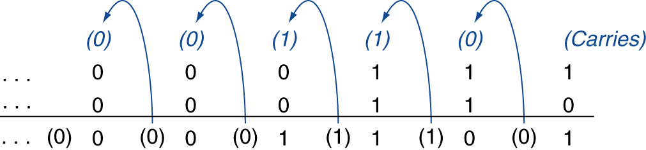
Integer Addition and Subtraction
Example: 7 + 6
Subtraction is an the addition of the negation of the second operand
Example: 7 – 6 = 7 + (–6)
+7: 0000 0000 … 0000 0111 –6: 1111 1111 … 1111 1010 +1: 0000 0000 … 0000 0001
§3.2 Addition and Subtraction

Slide 11
Examples of Overflow Detection
Overflow: the result is too large to represent in 32 bits
Overflow occurs when
adding two positives yields a negative
or, adding two negatives gives a positive
or, subtract a negative from a positive gives a negative
or, subtract a positive from a negative gives a positive
0
1
1
1
1
0
0
1
1
1
7
1
1
0
0
–4
+
0
0
1
1
3
+
1
0
1
1
–5
1
0
1
0
–6
0
1
1
1
7
Notes:
For lecture
Recalled from some earlier slides that the biggest positive number you can represent using 4-bit is 7 and the smallest negative you can represent is negative 8.
So any time your addition results in a number bigger than 7 or less than negative 8, you have an overflow.
Keep in mind is that whenever you try to add two numbers together that have different signs, that is adding a negative number to a positive number, overflow can NOT occur.
Overflow occurs when you to add two positive numbers together and the sum has a negative sign. Or, when you try to add negative numbers together and the sum has a positive sign.
If you spend some time, you can convince yourself that If the Carry into the most significant bit is NOT the same as the Carry coming out of the MSB, you have a overflow.

Slide 12
Summarizing: MIPS Overflow detection
Operation | Operand A | Operand B | Result indicating overflow
A + B | ≥ 0 | ≥ 0 | < 0
A + B | < 0 | < 0 | ≥ 0
A – B | ≥ 0 | < 0 | < 0
A – B | < 0 | ≥ 0 | ≥ 0
no overflow is detected when using
addu, addiu, subu, multu, divu, sltiu, sltu

Slide 13
Dealing with Overflow
Some languages (e.g., C) ignore overflow
Use MIPS addu, addui, subu instructions to ignore overflow
Other languages (e.g., Ada, Fortran) require raising an exception
Use MIPS add, addi, sub instructions to detect overflow
On overflow, MIPS invokes the exception handler
Save PC in Exception Program Counter (EPC) register
Jump to predefined handler address
mfc0 (move from system control) instruction copies EPC value to a general-purpose register to return to the offending instruction after corrective action

Slide 14
Arithmetic for Multimedia
Graphics and media processing operates on vectors of 8-bit (ex. colors) and 16-bit data (ex. sounds)
Many graphics and audio applications perform the same operation on vectors of media data
SIMD (single-instruction, multiple-data)
Use 64-bit adder, with partitioned carry chain
Operate simultaneous operations on 8×8-bit, or 4×16-bit, or 2×32-bit vectors
Saturating operations
On overflow, result is set to the largest representable value (most negative or most positive)
c.f. 2s-complement modulo arithmetic
E.g. a volume knob with saturation stops at the highest volume no matter how far you turn it.

Slide 15
Review: A Full Adder
carry_in
A | B | carry_in | carry_out | S
0 | 0 | 0 | 0 | 0
0 | 0 | 1 | 0 | 1
0 | 1 | 0 | 0 | 1
0 | 1 | 1 | 1 | 0
1 | 0 | 0 | 0 | 1
1 | 0 | 1 | 1 | 0
1 | 1 | 0 | 1 | 0
1 | 1 | 1 | 1 | 1
A
1-bit Full Adder
S
B
carry_out
S = A ⊕ B ⊕ carry_in (odd parity-function)
carry_out = A&B | A&carry_in | B&carry_in
(majority function)
How can we use it to build a 32-bit adder?
How can we modify it easily to build an adder/subtractor?

Slide 16
A 32-bit Ripple Carry Adder/Subtractor
add/sub
c₀=carry_in
A₀
1-bit FA
S₀
Remember 2’s complement is just
complement all the bits (xor)
add a 1 in the least significant bit
B₀
c₁
A₁
1-bit FA
S₁
B₁
control
(0=add,1=sub)
c₂
B₀ if control = 0, !B₀ if control = 1
A₂
1-bit FA
B₀
S₂
B₂
c₃
. . .
A 0111 → 0111 B - 0110 → +
c₃₁
A₃₁
1-bit FA
1001
S₃₁
1
B₃₁
0001
c₃₂=carry_out
1 0001
Notes:
The xor complements each bit of B
C₀ = 1 since we must add 1 to B to obtain the 2s’ complement.
So first step we add a0 + b0 + c0 then we proceed with the rest of the addition.

Slide 17
Multiply
Binary multiplication is just a bunch of right shifts and adds
n
multiplicand
multiplier
partial
product
array
can be formed in parallel and added in parallel for faster multiplication
n
double precision product
2n

Slide 18
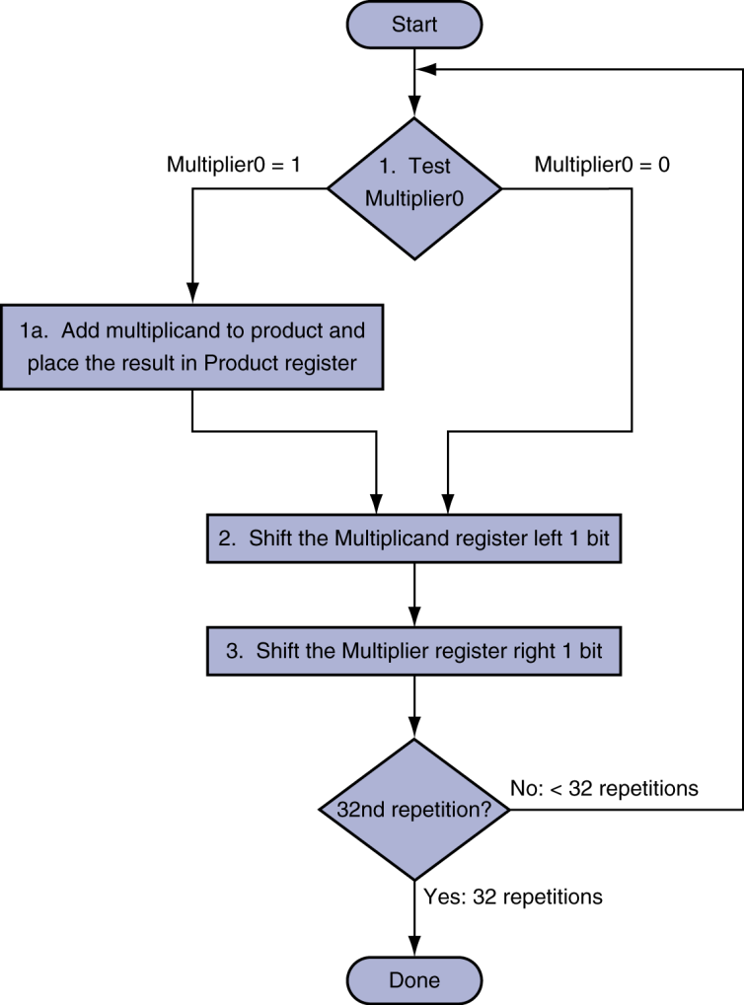
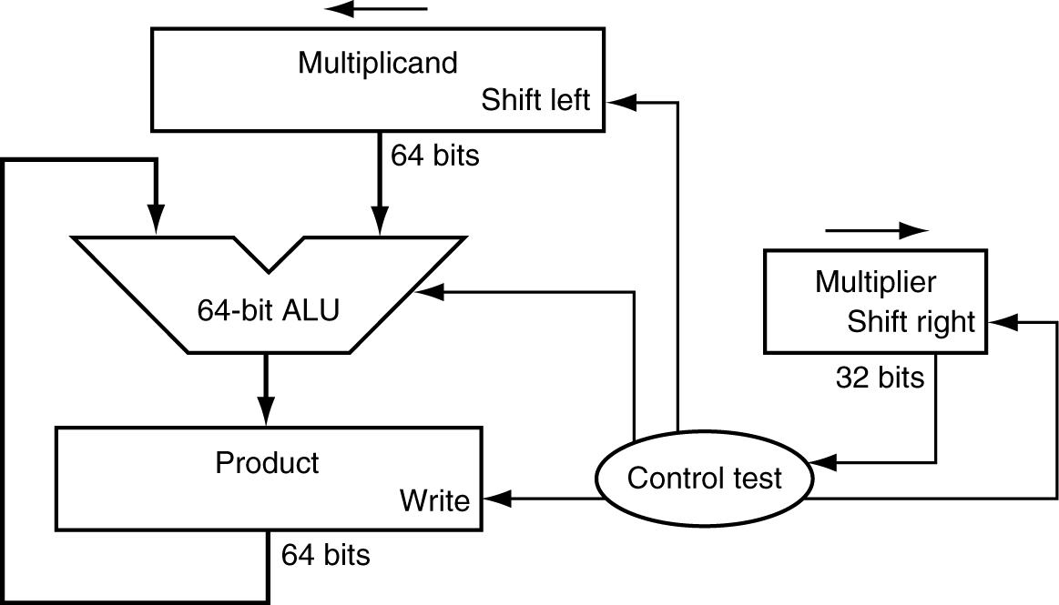
Multiplication Hardware
Initially 0

Slide 19
Multiplication
§3.3 Multiplication
Start with long-multiplication approach
multiplicand
1000
× 1001
1000
0000
0000
1000
1001000
multiplier
product
Length of product is the sum of operand lengths
Initially 0

Slide 20
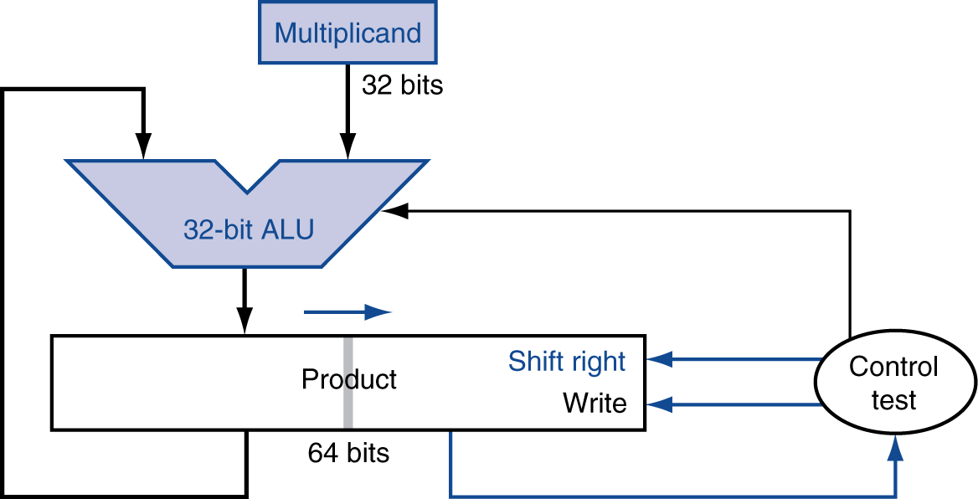
Optimized Multiplier
Perform steps in parallel: add/shift
One cycle per partial-product addition
That’s ok, if frequency of multiplications is low

Slide 21
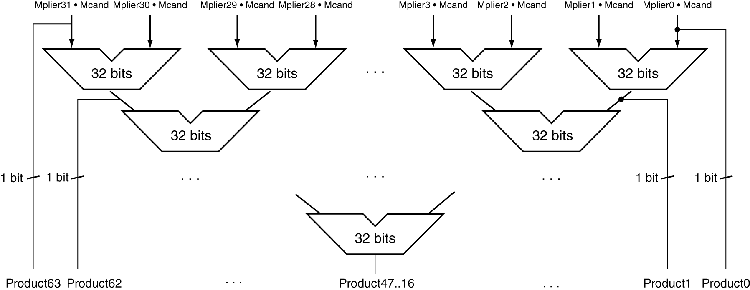
Faster Multiplier
Uses multiple adders
Cost/performance tradeoff
Can be pipelined
Several multiplication performed in parallel

Slide 22
MIPS Multiplication
Two 32-bit registers for product
HI: most-significant 32 bits
LO: least-significant 32-bits
Instructions
mult rs, rt / multu rs, rt
64-bit product in HI/LO
mfhi rd / mflo rd
Move from HI/LO to rd
Can test HI value to see if product overflows 32 bits
Signed Multiplication
Convert Multiplicand and Multiplier to positive and remember the original signs. Product is negative if the original signs disagree.

Slide 23
Next Lecture and Reminders
Next lecture
Improving Multiplication
Addressing Division and Floating Point
Reading assignment – PH, Chapter 3, 3.4-3.6 and 3.8

